Slide 1
backyard berry
Team 2: The Berry Bunch
02/13/20

Slide 2
User Scenarios
[ ]
Registered User:
Access to a profile page
Access to past logs/records of harvests
Private Locations.
Data sharing
“public” (for all eyes)
“private” (for their eyes and the scientist’s eyes).
Access to map of available patches, a berry identification section, information on the fruit fly, a harvest form, and cultural uses of berries.
Unregistered Guest User:
Access to a map of available patches, a berry identification section, information on the fruit fly, a harvest form, and cultural uses of berries.

Slide 3
Guest User
Scenario:

Slide 4
Application Users & Environment
Users
Foragers
Scientists
Tourists
Residents in the Great Lakes Region
Environments
On a laptop or phone
– at home, in a vehicle, in the woods
– Before or after a harvest
– Before or after looking for berries
– looking for a berry patch
– logging a berry patch
Example:
On your phone, in a vehicle headed back from a berry patch logging berries.
Notes:
Foragers – Those who pick berries at you-pick farms or wild berries in the Great Lakes Region
Scientists – Tara Bal, Angie Carter, Erika Hersch-Green
Tourists – people who have come to the Great Lakes Region and want to go berry picking
Residents in the Great Lakes Region who are not regular foragers, but would like to go berry picking on occasion

Slide 5
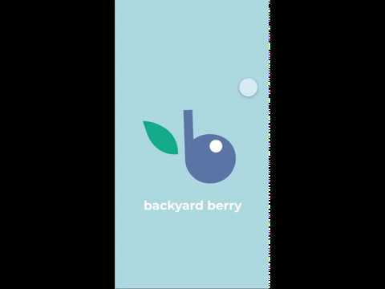
Prototype Demo

Slide 6
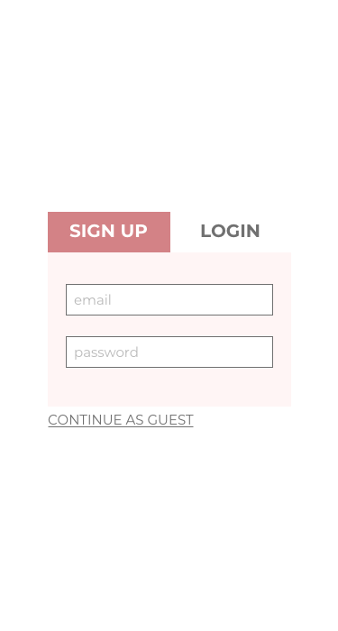
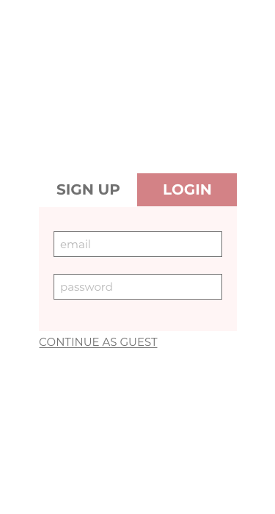

Slide 7
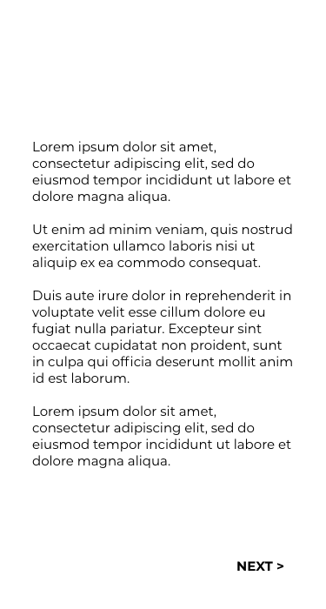
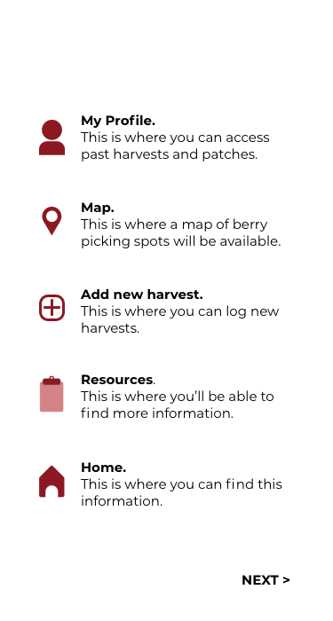
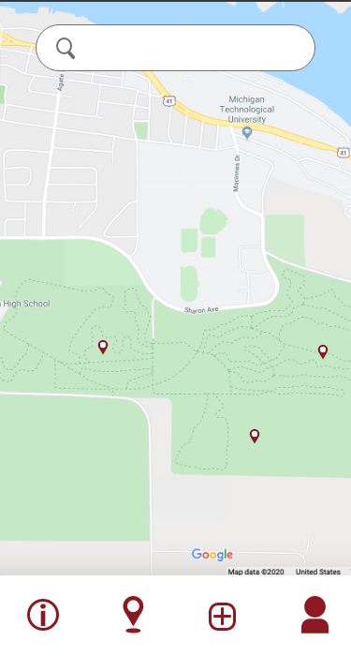

Slide 8
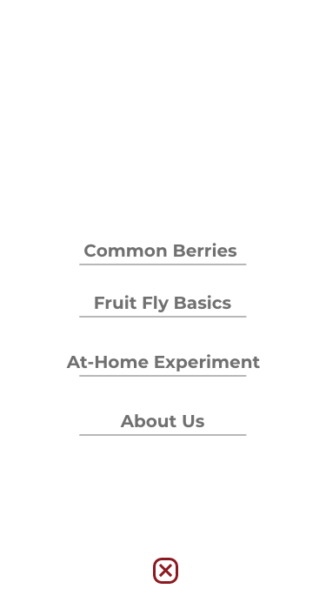
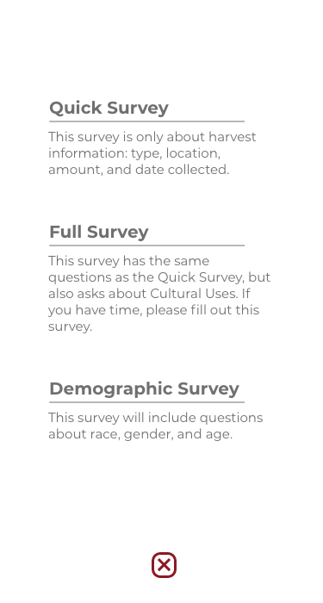
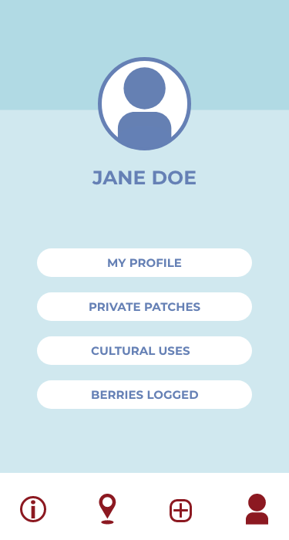

Slide 9
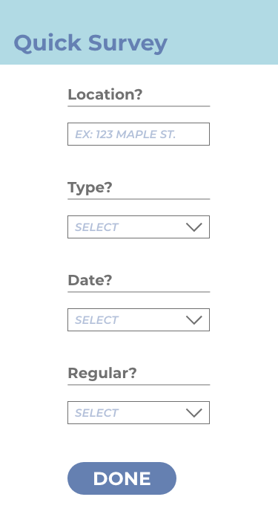
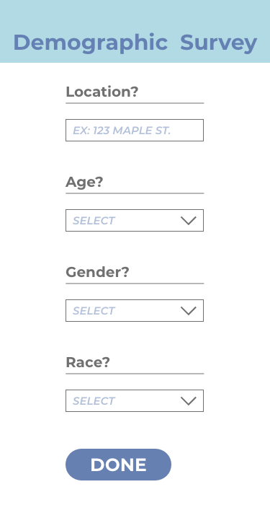

Slide 10
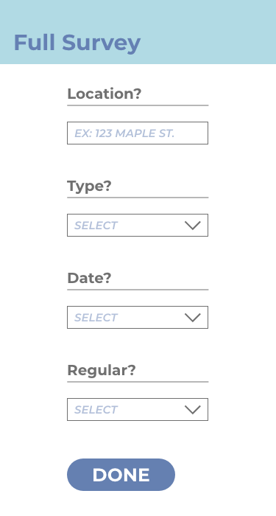
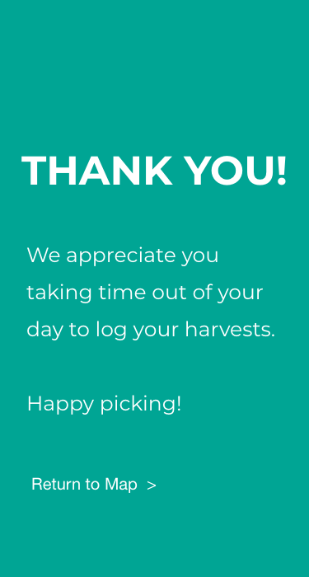

Slide 11
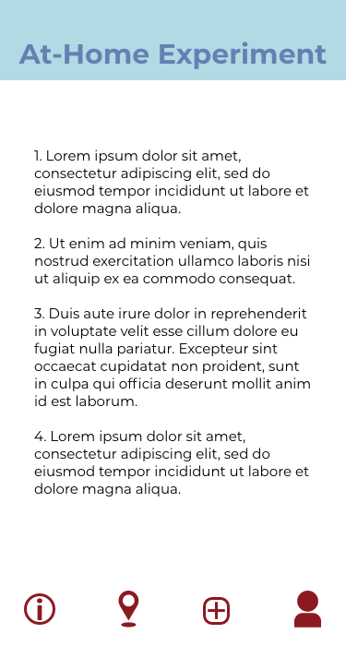
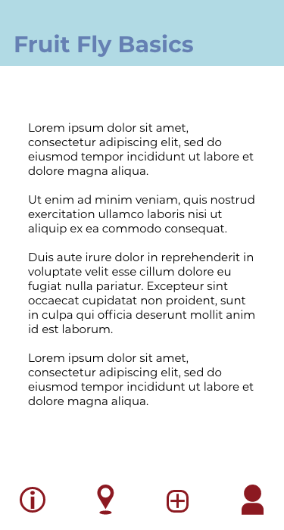
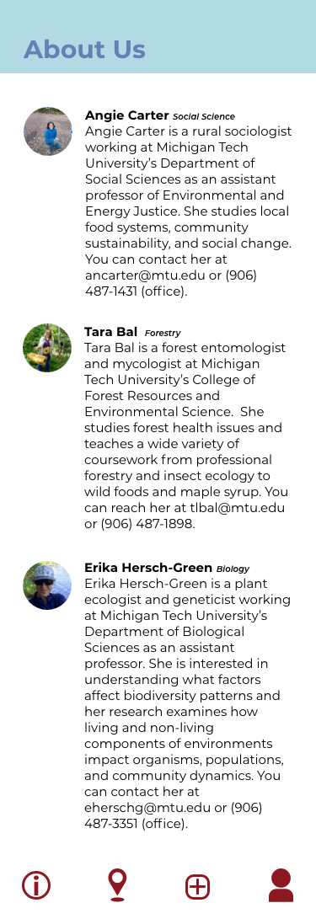
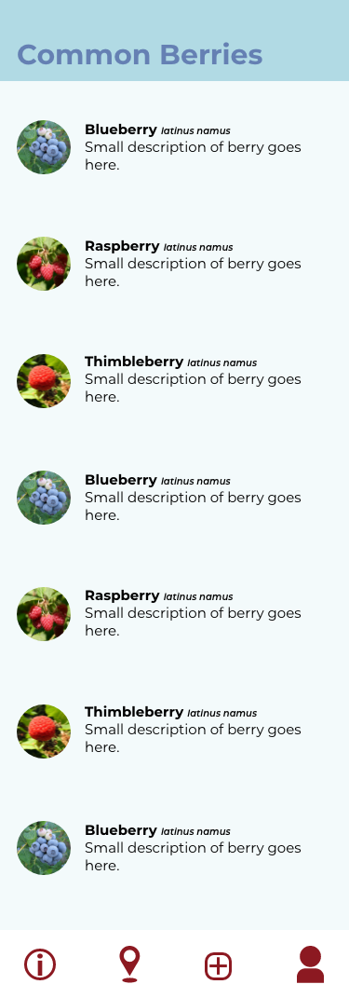

Slide 12
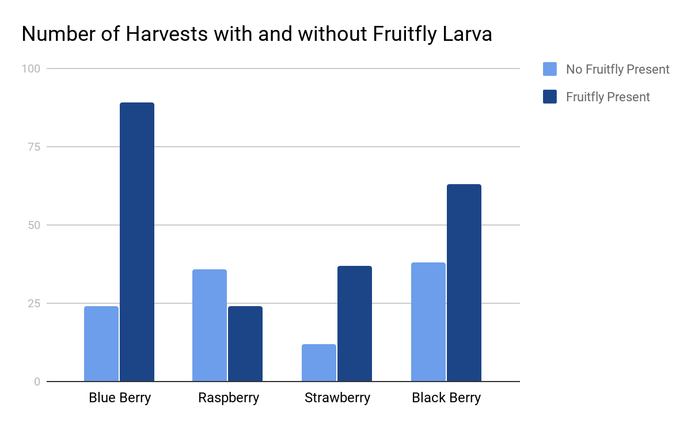
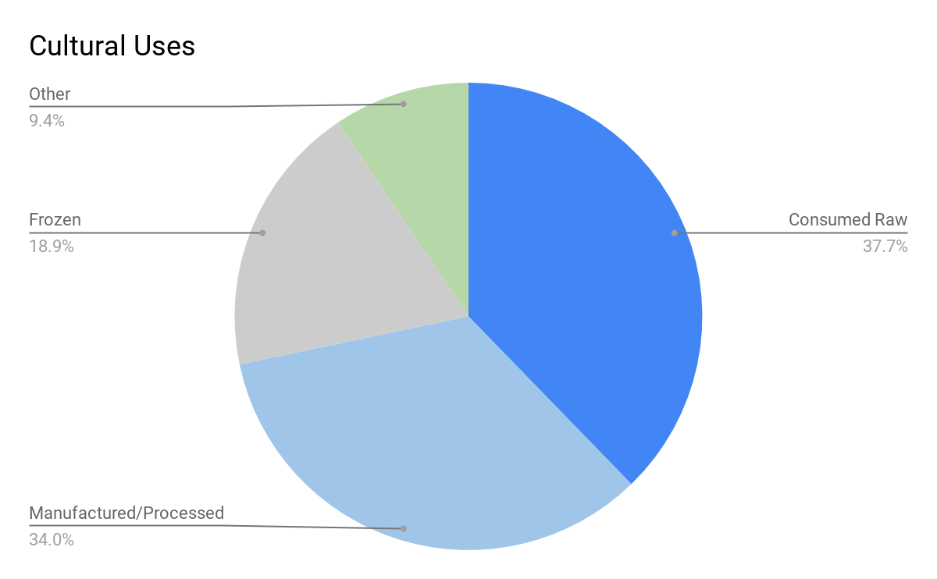
Scientist View
Home
Download Data
Log Out

Slide 13
Goals & Concerns
Concerns
Navigation
Are the icons clear enough?
Do they communicate what they need to?
Should there be a home button?
User profile?
Motivation
Get the word out and recruit users
Create a desire to use the app
Usability
Is it user-friendly?
Are instructions clear and where they need to be?
Will text be readable?
Feasibility
Is the project too complicated for the time frame?
Goals
Simple user-friendly interface
User-test with users outside of our generation
Create easy-to-understand Scientist Materials

Slide 14
Preliminary Instructional & Other Content
First-time user informational content
App overview
Icon descriptions
Map use description
Berry information
Common names
Pictures
Identifying features
At-home fruit-fly larvae test
“About Us” page
Background information on the scientists

Slide 15
QUESTIONS?

